Slide 1

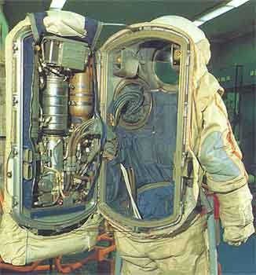
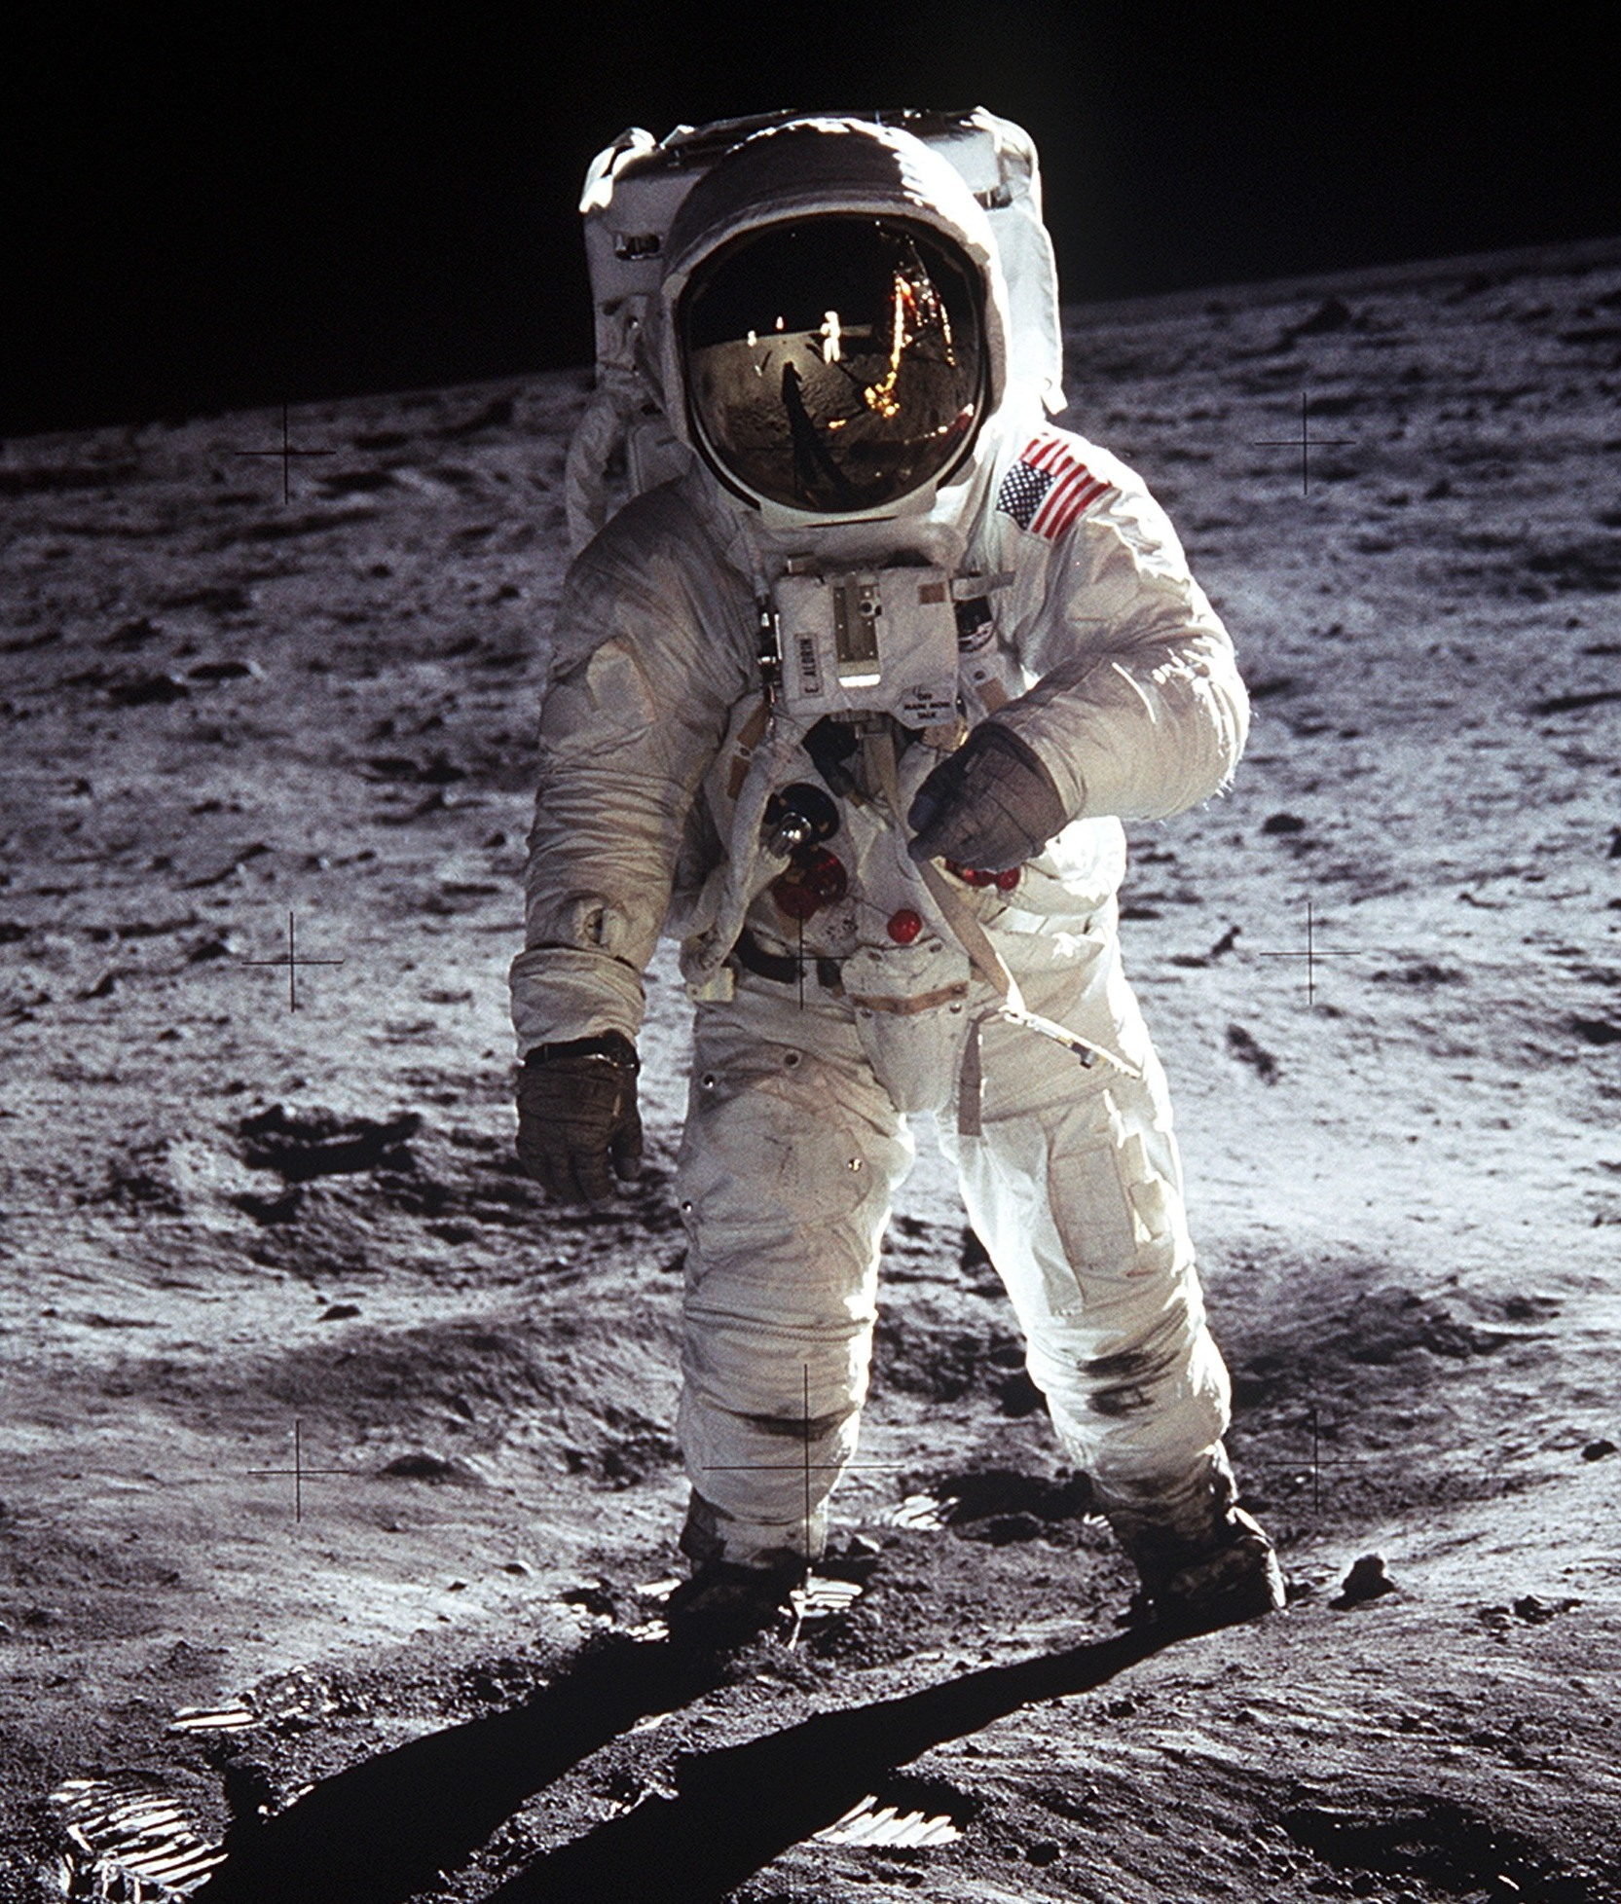
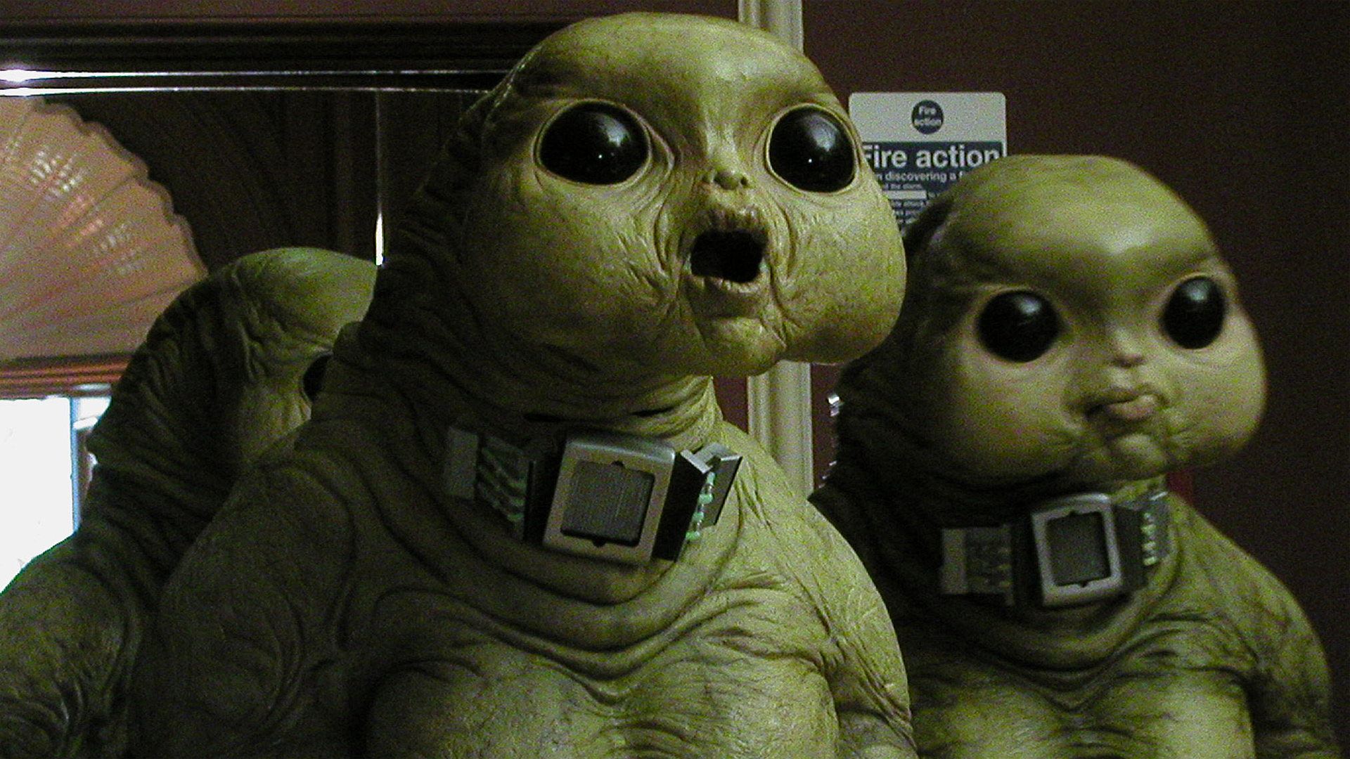
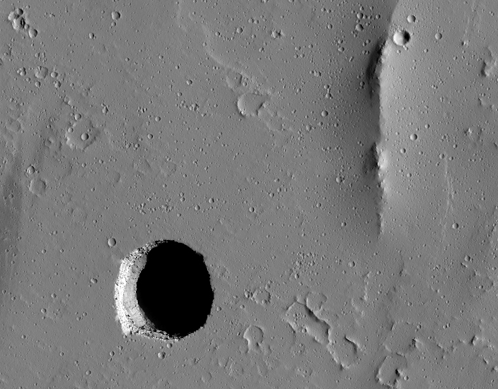

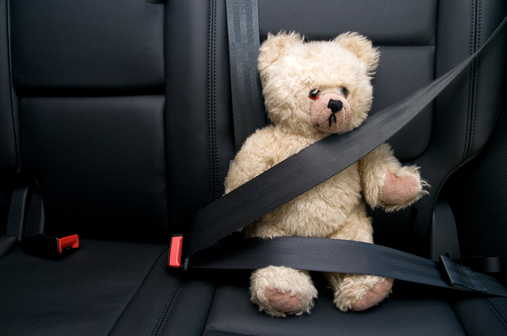
What you need to do to be save!!!
Safety Procedures in V886 Centauri. Be careful from Aliens | Check the amount of oxygen every 5 mins. | Don’t take out the spacesuit when you are outside of station.
Be careful for your steps (don’t fall into the hole). | Safety Procedures that relate to travel. Wearing seatbelts. | Take off your glasses (You can wear it after we arrived).
MaggieInc.com

Slide 2

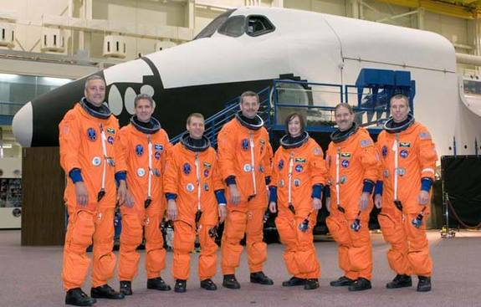
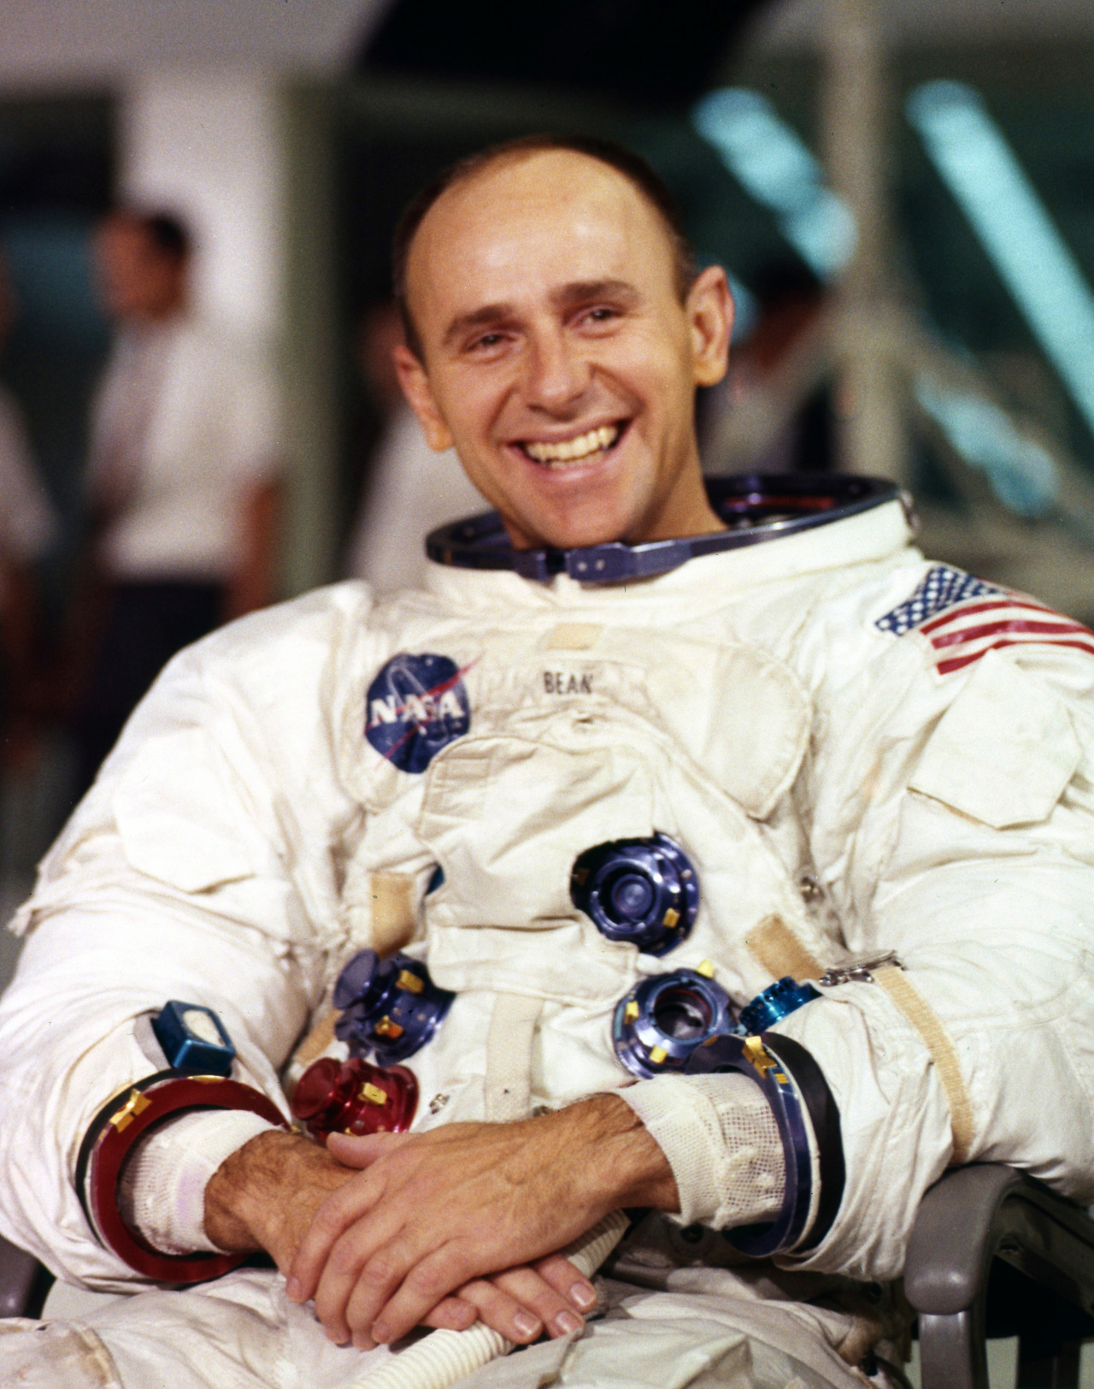
Be ready for your spacesuit and wear it before we leave the Earth. | Don’t move while you are in the rocket.
The importance of SAFETY can keep us away from danger. We can make our journey more easily, and have great fun during the trip in the space. Hope you enjoy it!!
MaggieInc.com

